Slide 1
Analyzing Swiggy

Slide 2
Objective
Problem Statement
The online food ordering market includes foods prepared by restaurants, prepared by
independent people, and groceries being ordered online and then picked up or delivered.
The first online food ordering service, World Wide Waiter (now known as Waiter.com),
was founded in 1995. Online food ordering is the process of ordering food from a website
or other application. The product can be either ready-to-eat food or food that has not been
specially prepared for direction consumption.

Slide 3
Approach
Do ETL : Extract-Transform-Load the dataset and find for me some
information from this large data. This is form of data mining.
What all information can be achieved by mining this data, would be
explained in class by the trainer
Find key metrics and factors and show the meaningful relationships between attributes.
Do your own research and come up with your findings.

Slide 4
Data
Csv File
Power BI file(.pbix)
Python notebook
Data types of columns
Columns
Type of data

Slide 5
Architecture
Data Preparation and Cleaning
Understanding data
Discovering insights and generating reports

Slide 6
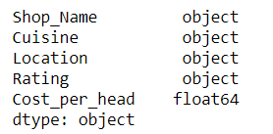
Data Validation and data transformation
Column Transformation: Created a column for the cost per head derived from the column cost for 2 heads
Number of columns:
Numerical-3
Categorical-3
Data types of the columns:

Slide 7
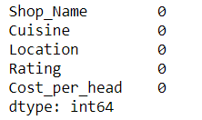
Data validation
Checking for null values in the database

Slide 8
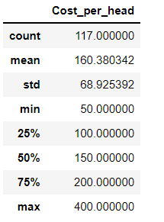
Understanding data
The shape of the dataset is of (117,5)
The index of the dataset is from 0 to 117
Description of the dataset

Slide 9
Exploratory data analysis
By using Pandas for deriving insights from the data , following insights are :
count of ratings for the cuisines
count of ratings
ratings of shop names
max cost for the shops
max ratings for the locations
max rating
max cost

Slide 10
min cost
Unique ratings
Unique shops
Unique cuisines
Non rated shops
Min rating

Slide 11
Reports and visualizations
Following visuals are added to the reports and dashboards:
cost per head with ratings and cuisines
cost per head and the ratings
Analysis of cuisines with their locations
Analysis of ratings with the cuisines
Analysis of ratings with the locations
Analysis of shops with their ratings and cuisines
Min cuisines with ratings and cost per head
Max cuisines with ratings and cost per head

Slide 12
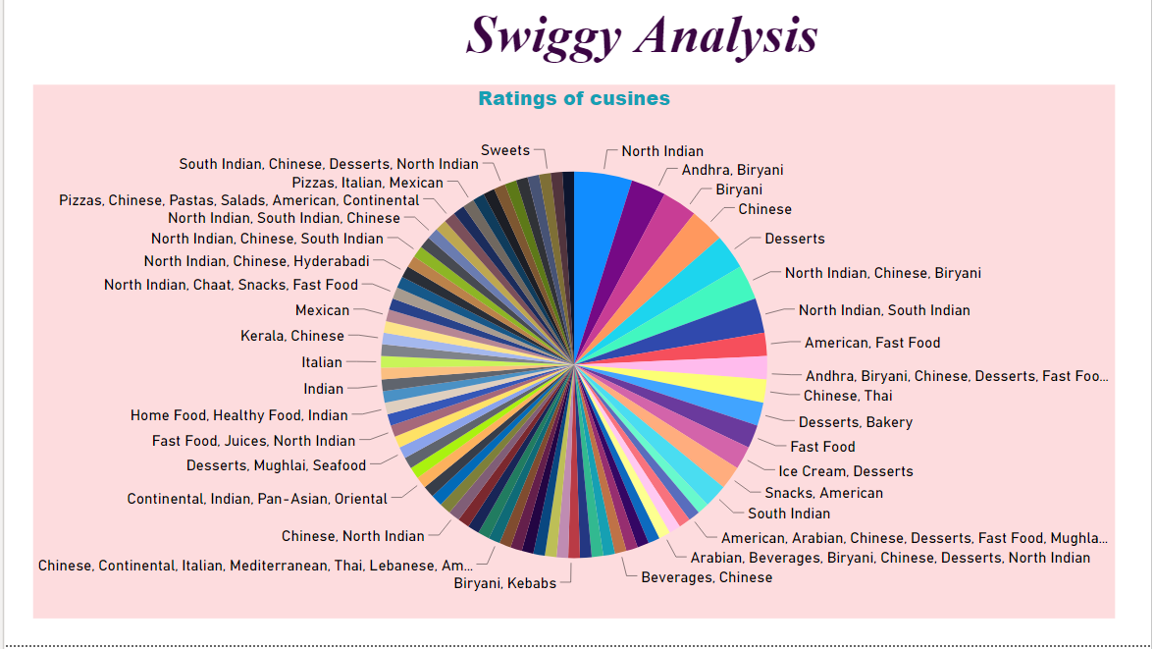
Visualization
The visualization displays about the Ratings of the cuisines
Insights from the visual:
Ratings of the cuisines
Max rating is for north Indian Cuisine
Min ratings for American , sweets , grills, Portuguese.

Slide 13
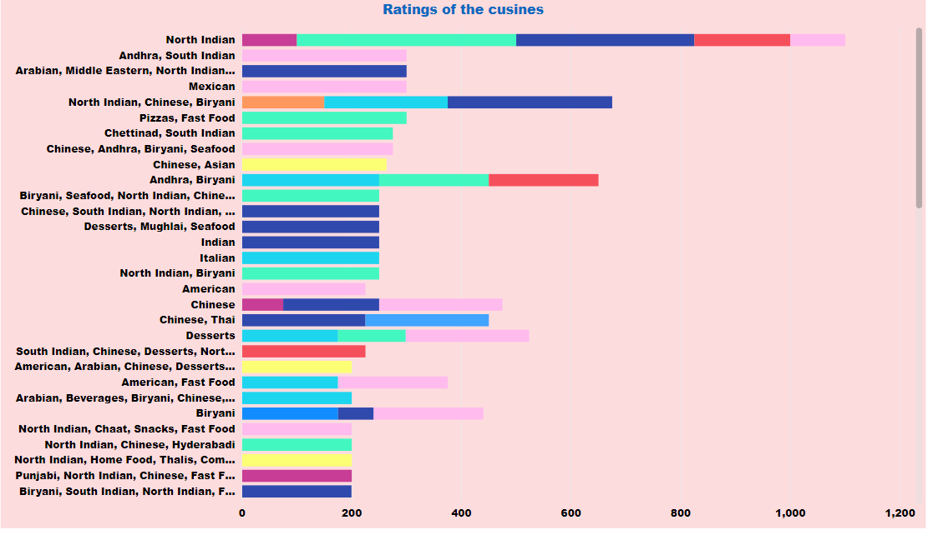
This Visualization displays the ratings of the cuisines with the max cost
Insights from the dataset:
North Indian Cuisine with rating 4 cost for per head is 400/- is max cost.
Biryani with rating 4.1 is the less cost per head of 65/-

Slide 14
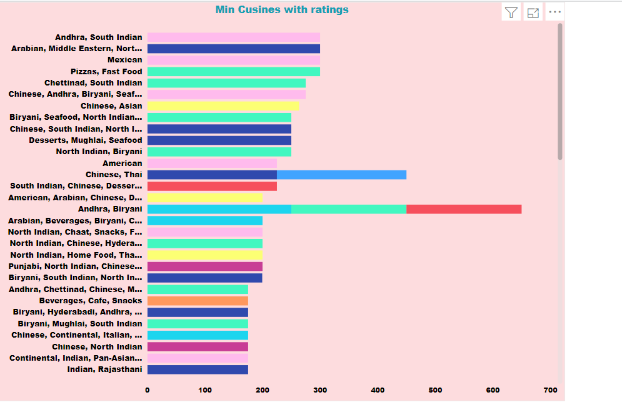
The Visualization displays about the cuisines with their ratings , min cost and locations
Insights from the visual:
Min cuisines like Andhra , south india, north india, biryani and hyderabadi cost around 175/- per head with rating 4.1.
Chinese , Thai cuisine with rating 4.5 cost per head is 225/- at max.

Slide 15
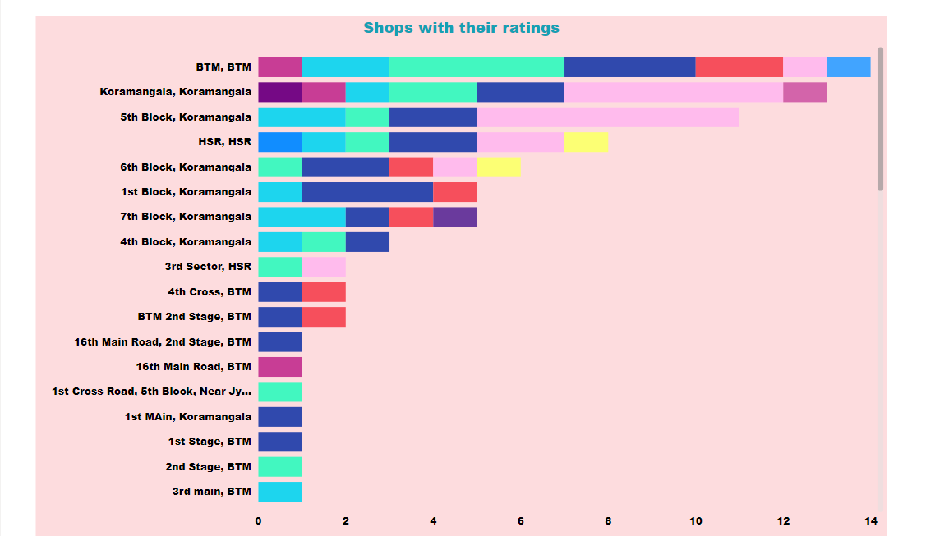
This Visualization displays about the shops with their ratings and locations
Insights from the visual:
More number of shops are available at Koromangala of Biryani and American with rating 4.3
Less number of shops at HSR with rating 4.4 for American , Chinese , deserts , fast foods etc.

Slide 16
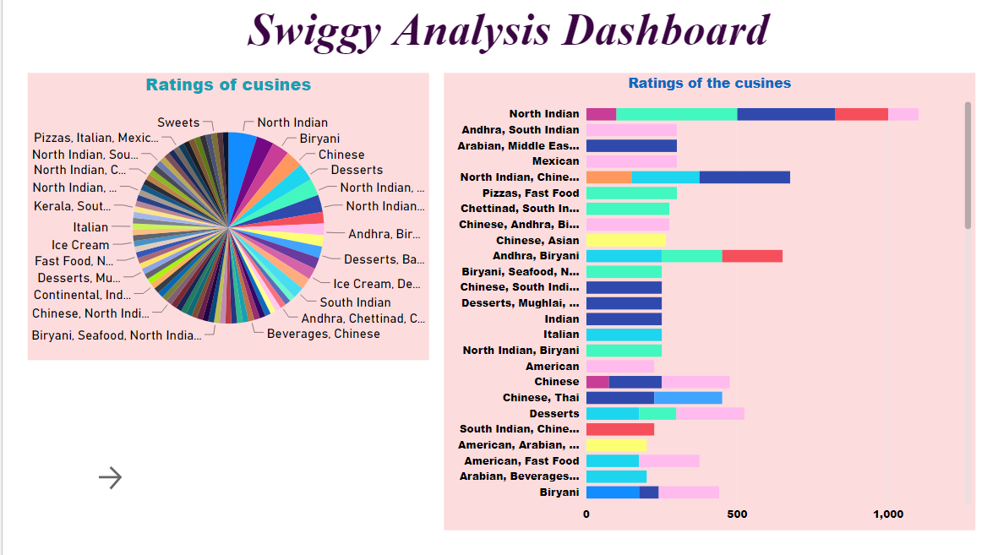
Dashboard
The dashboard gives the analysis of the ratings of the cuisines and locations.
Insights from the dashboard:
More ratings for the cuisines are at 1st Block Koromangala for the Andhra, Biryani , Chinese , Conrtenental etc , fast foods, North Indian. With minimum cost.

Slide 17
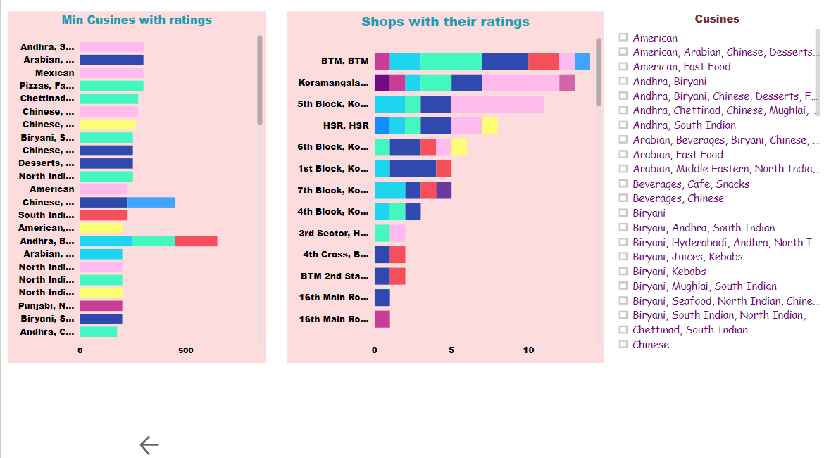
The dashboard gives the ratings of the cuisines with their shops and locations.
Insights from the dashboard
More shops are there at BTM with cuisines like north india, south india , Andhra , biryani , Chinese , beverage , Thai , Italian , hyderabadi , Italian etc.

Slide 18
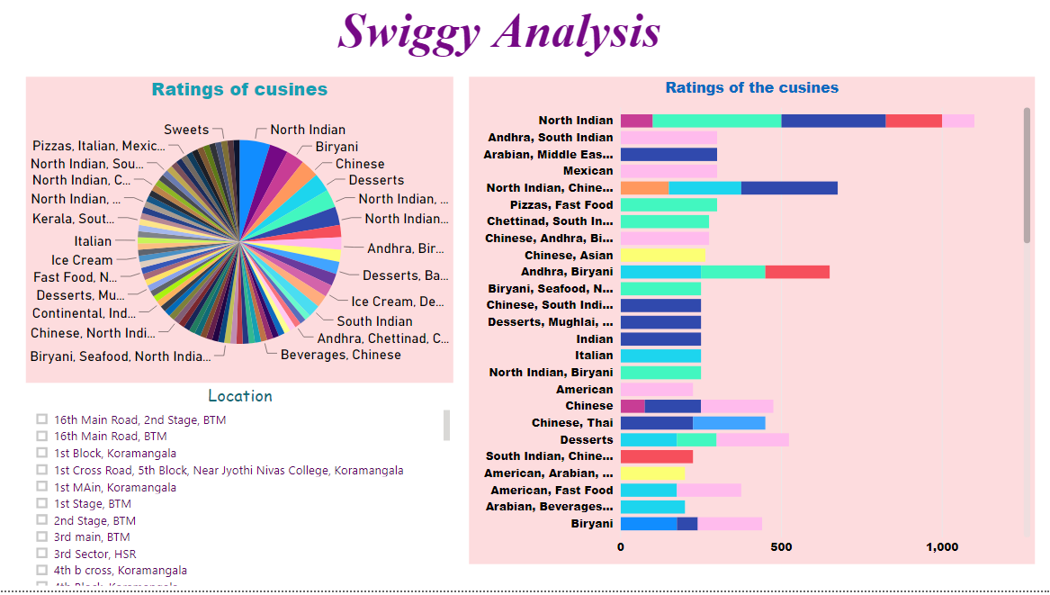
The dashboard gives the insights of the ratings of the cuisines and their locations.
Insights from the dashboard:
Biryani with rating 4.3 of cost 150/- per head at chocolate road , BTM.
More locations are at like HSR, BTM and Koromangala

Slide 19
Q and A
Q1. What is the source of the data?
https://drive.google.com/drive/folders/1FkmFVL8wlJmQWP1z52TD8PlhOJhitTyI?usp=sharing
Q2. What is the type of data variables?
Categorical and numerical
Q3. What techniques are used to perform data preparation?
Removing columns
Deriving column
Filtering the values
Checking for null values

Slide 20
Q4. What libraries are used to perform data visualization?
Seaborn

